Slide 1

FINDING THE NUCHAL TRANSLUCENCY THICKNESS FROM ULTRASOUND IMAGE
BY
ASHUTOSH Jha
3rd YEAR
MANIPAL INSTITUTE OF TECHNOLOGY

Slide 2
INTRODUCTION
Nuchal translucency (NT) thickness is a prenatal screening measurement used to assess the risk of certain chromosomal abnormalities in a developing fetus, particularly Down syndrome (Trisomy 21), as well as other genetic disorders. This measurement is typically performed during the first trimester of pregnancy, around the 11th to 14th week, and is part of a larger assessment known as the first trimester combined screening or the first trimester screening.

Slide 3
PROJECT GOALS
The main objective of this project is to come up with image processing techniques which will help us get the most accurate region of interest and a model which can then be implemented to find the NUCHAL TRANSLUCENCY THICKNESS accurately and compare it with the normal range.

Slide 4
METHODOLOGY
We basically followed the following steps in order to come up with the final convolution neural network model, we will talk in detail about each step ahead in the report.
Loading the dataset
Importing the required libraries
Image processing
Data preprocessing
Making the segnet Model
Predicting the mask
Calculating the NT thickness

Slide 5

Loading the dataset
We took the help of the provided codes to load the data to our kernel.

Slide 6
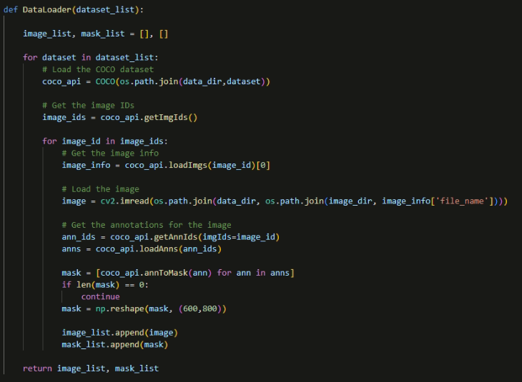

Slide 7
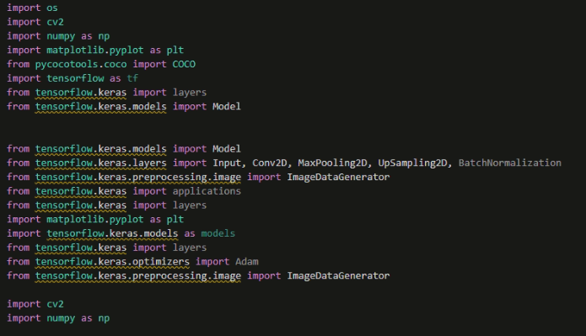
Importing Required Libraries

Slide 8
Image Processing
We followed the following steps to perform Image Processing.
Adaptive Filtering : Ultrasound images often exhibit variations in noise levels and signal intensity, especially when imaging soft tissues. Adaptive mean filtering adjusts the filter kernel size based on the local characteristics of the image. It means that in regions with low noise, the filter preserves fine details, while in noisy areas, it provides effective noise reduction. This adaptivity is crucial in NT thickness measurement

Slide 9



Image Processing
Histogram Equalization : enhance contrast by redistributing intensities so that they cover entire range of possible values.
ROI Selection: selecting the region of interest to work upon with the help of the masks.
Defining Contours : In this step we define the edges of the ROI .

Slide 10
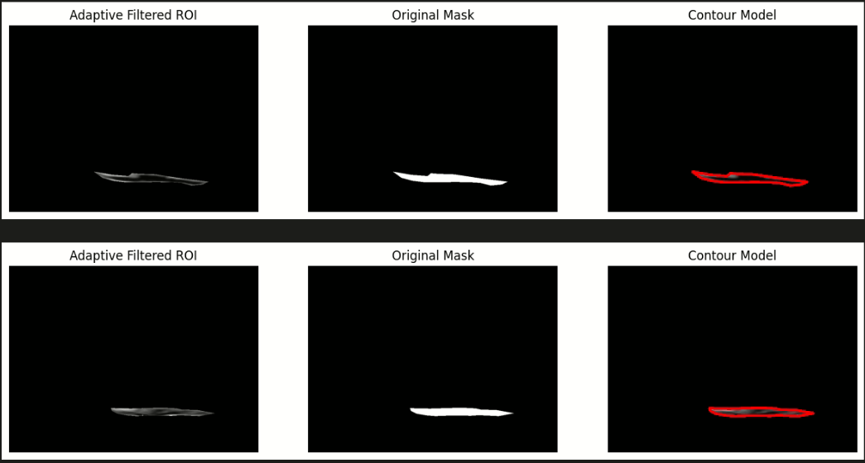
Image processing Output

Slide 11
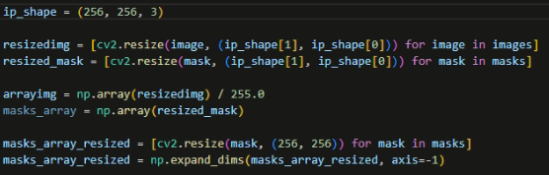

Data Pre-processing
We perform several operations in this step, we first RESIZE the data given to us after that we make them into an array after normalizing the values, after this we re-size the arrays formed too.
After this we divide the dataset into training and testing sets.

Slide 12
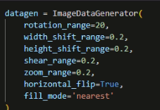
Data Pre-processing
To avoid underfitting of the model we create more similar data from the available data.

Slide 13
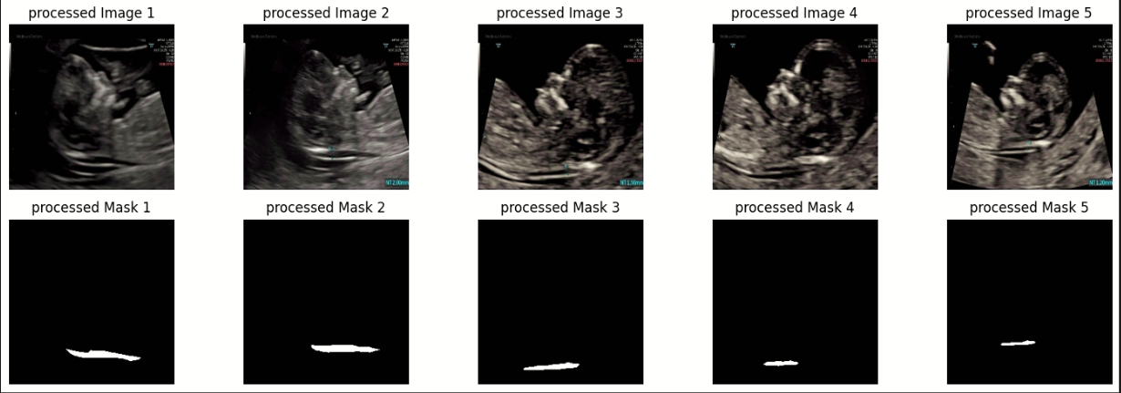
Data Pre-processing Output

Slide 14
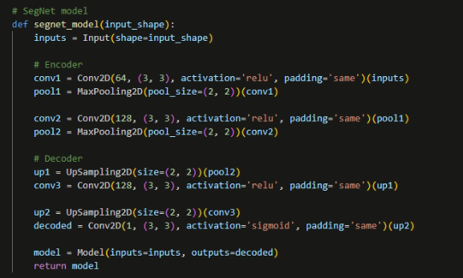
Making The Segnet Model
Segnet Model : SegNet is a semantic segmentation model. This core trainable segmentation architecture consists of an encoder network, a corresponding decoder network followed by a pixel-wise classification layer.
model1
NOTE: We had to make custom Segnet models and reduce a few layers in encoder and decoder to show implementation as it was taking too long to train the model with a lot of layers.

Slide 15
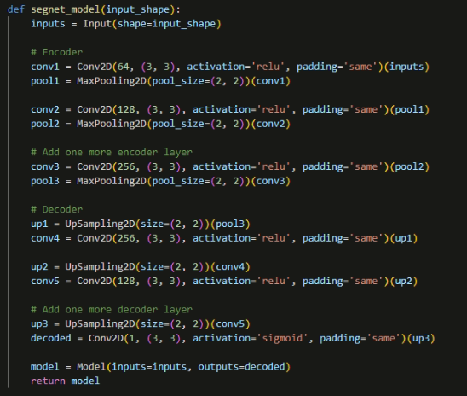
Model 2

Slide 16
Making The Segnet Model
After making the model structure we have compiled the model, trained it and then tested it.

Slide 17
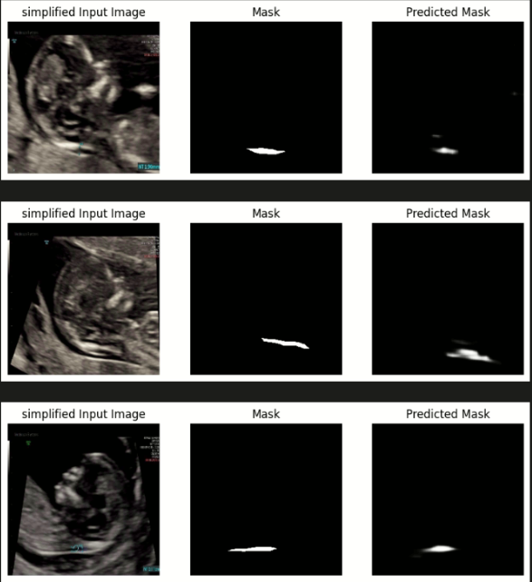

Predicting the Mask
In this step we are predicting the size and shape of the mask of a given Image with the help of the trained model.
Output of predictions

Slide 18
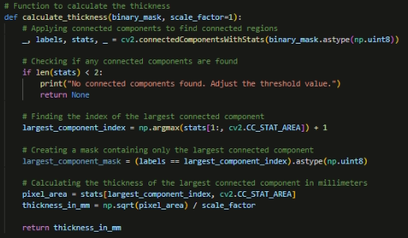
Calculating the NT Thickness

Slide 19
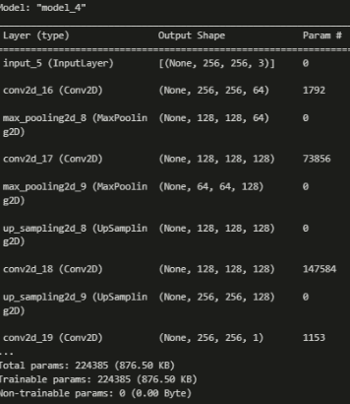
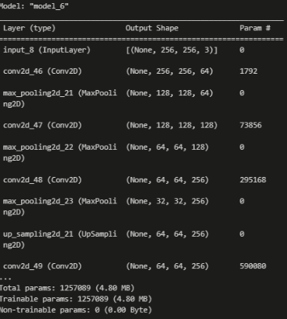
Comparison Of Models - Structure
MODEL 1
MODEL 2

Slide 20
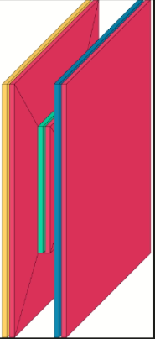
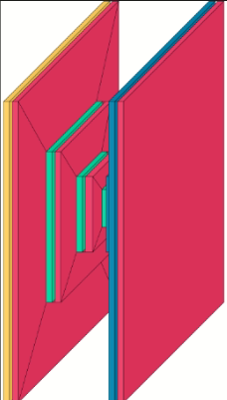
Comparison Of Models – Structure diagram obtained from Visualkeras
MODEL 1
MODEL 2

Slide 21
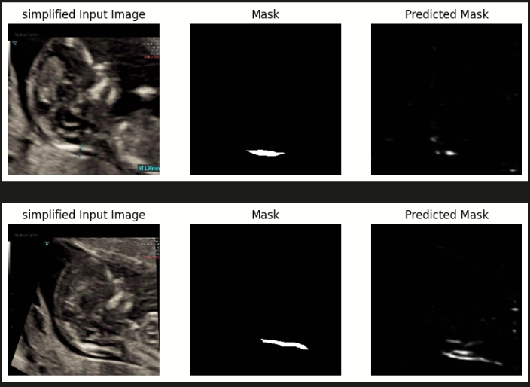
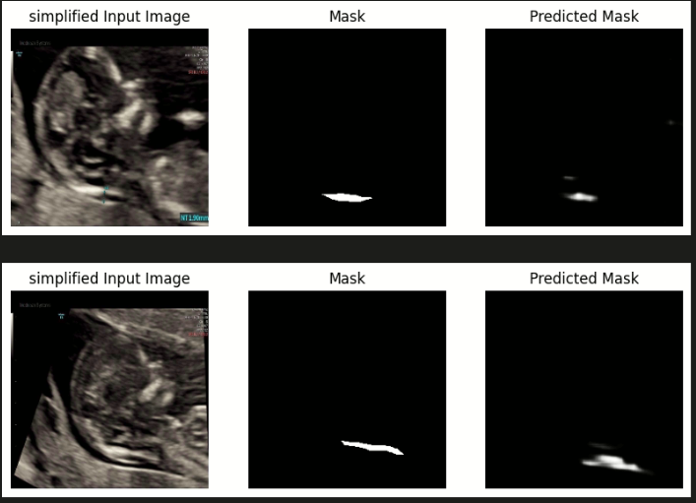
Comparison Of Models – Mask Prediction
MODEL 1
MODEL 2

Slide 22
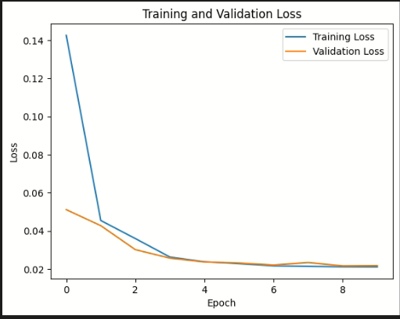
Comparison Of Models – Accuracy
MODEL 1

Slide 23
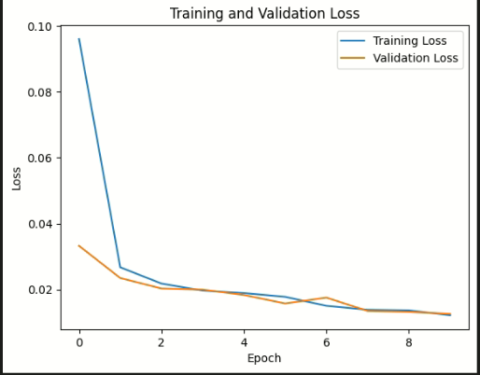
Comparison Of Models – Accuracy
MODEL 2

Slide 24
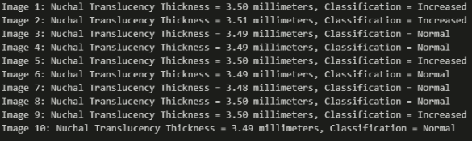
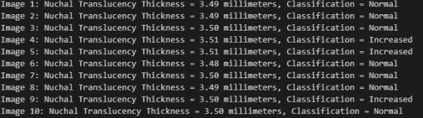
Comparison Of Models – RESULTS
MODEL 1
MODEL 2

Slide 25
Conclusion :
We can observe that the segnet model with more encoder and decoder layers is able to make predictions more accurately and hence provide us with better estimate of the NT Thickness.

